Slide 1




Slide 2

BUSINESS ETIQUETTE
MANNERS, LANGUAGE, CUSTOM, TRADITION AND VALUE

Slide 3
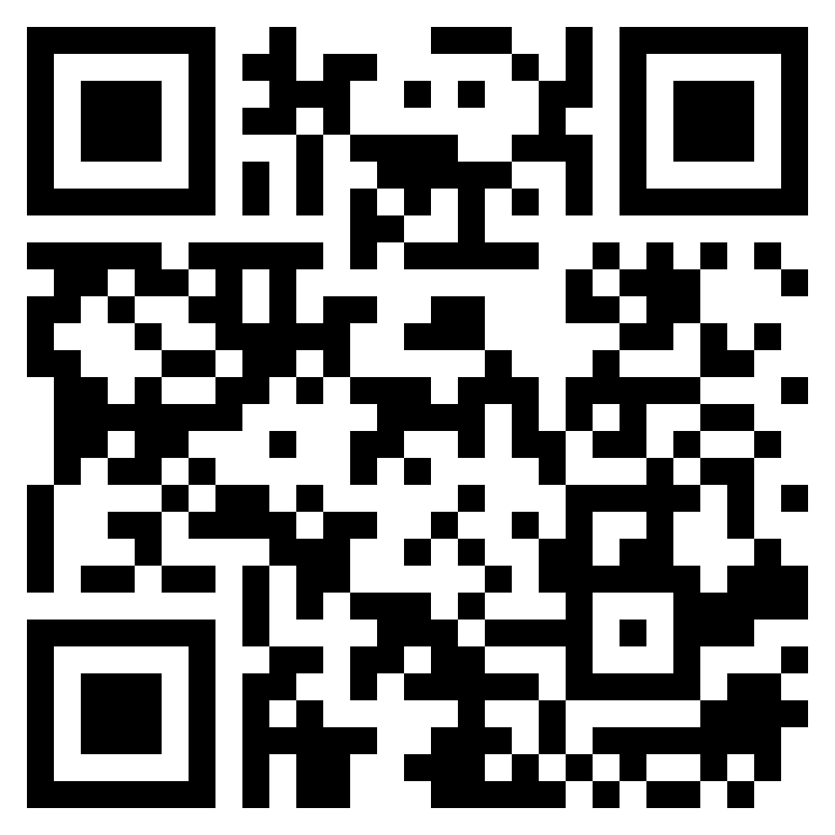
Topic Name
TEST TIME ON READING COMPREHENSION
URL: https://forms.gle/KAAoYG5hQs65tnom7
QR CODE:

Slide 4
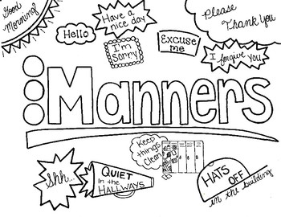
BUSINESS ETIQUETTE
MANNERS, LANGUAGE, CUSTOM, TRADITION AND VALUE
What is manners?
Notes:
This is the template for slides with only an image

Slide 5


Importance of Good Manners
Significance
Effects
Netiquette
Impressions
Considerations
Notes:
IMPORTANCE OF GOOD MANNERS
Etiquette is a set of unwritten rules that apply to social situations, professional workplaces and relationships. In the business world, good business etiquette means that you act professionally and exercise proper manners when engaging with others in your profession. Good business etiquette is a valuable skill-set that will make you stand out from others, enhance your chances at success and help you land that dream job.
1. Significance
In business, the relationships you build are critical. Establishing good rapport is significant if you want to progress your professional future, take on new clients, impress your boss or close that final sale. The way to build positive relationships in the business world is by exercising good etiquette, specifically by exhibiting top- notch communication skills. If others are speaking, give them your full attention and make eye contact to let them know you are engaged in the conversation. This is known as active listening. When it is your turn to speak, be clear and concise, and avoid jargon that your audience would not understand. Add a smile and a handshake so others find you pleasant to work with
2. Effects
Good business etiquette is the recipe for advancing your career. In the business world, people with good etiquette are
rewarded for their professional and polite skills.
For example, an employee who arrives at a meeting on time (or early) and is ready to take notes has a better chance of impressing his supervisor than the employee who shows up to the meeting late, and forgets to bring a pen.
Those who exemplify good business etiquette are proving that they respect their position, job, co-workers and take their performance seriously. As such, these individuals win promotions and get ahead in their careers.
3. Nettiquette
Netiquette is etiquette that takes place over virtual mediums, such as email. Virtual communication is popular in the business world, so it is critical that businessmen and women have the right netiquette to maintain professionalism. Compose emails the way you would write a letter. Use complete sentences and proper grammar, and check your email for correct punctuation usage and other technical errors. Avoid using jargon, abbreviations and emoticons. Do not type emails in all capital letters, as this is construed as yelling.
4. Impressions
The way you dress, for instance, impacts the way you are perceived by others. Other peoples’ impressions of you should be positive so that they continue doing business with you. To accomplish this, start with your attire.
Ask yourself if you look professional, or if your outfit needs some fine-tuning. Looking sloppy, messy and dirty will put off your co- workers and turn away potential clients.
5. Considerations
Business etiquette extends beyond the office. When you are required to attend a business luncheon or dinner, it is important that you adhere to tableside etiquette standards as well as business etiquette. People with good dining manners can win over their colleagues and counterparts, whereas people with poor conduct may miss out on business deals, according to the International Etiquette Centre.

Slide 6
Ways to Exhibit Good Manners in Workplace
Take responsibility
Respect other people’s space and property
Monitor the level of your conversation
Minimize personal communications
Notes:
WAYS TO EXHIBIT GOOD MANNERS IN WORKPLACE
We all know that the essence of good manners and etiquette is to be respectful and courteous to all in all the time. When it comes to workplace etiquette, there are written and unwritten rules. The written rules are often found in policy manuals and guidebooks. But not so for the unwritten rules, which may take some figuring out. We can observe the behaviours of senior level managers for clues, but oftentimes, the unwritten rules for workplace etiquette boils down to common sense. Following are the ways to exhibit good manners in the workplace.
1. Take responsibility
If you make a mistake on a critical project, immediately take responsibility, do not blame others, or make excuses. If you realize that you are in the wrong, apologize and move on.
2. Respect other people’s space and property
Because people may work in cubicles doesn’t mean that they do not have the right to privacy. Do not enter another person’s space unless invited to do so, or use their properties without express permission.
3. Monitor the level of your conversation
Privacy is sometimes very difficult to find in today’s workplace, so check the level of your conversations to ensure you are not disturbing other co-workers.
4. Minimize personal communications
Keep personal emails and telephone conversations to a minimum on work time.

Slide 7
BUSINESS ETIQUETTE
Ways to Exhibit Good Manners in Workplace
Dress appropriately
Listen first, and then respond
Customers are gold
Notes:
WAYS TO EXHIBIT GOOD MANNERS IN WORKPLACE
5. Dress appropriately
Tank tops, leggings and flip flops aren’t appropriate in a corporate setting, even on casual Fridays. Dress professionally, and dress for the position that you are aspiring for.
Make sure your clothing is comfortable and the proper fit. If you can afford to do so, hire an image consultant to help to coordinate your wardrobe and choose the colours that are appropriate for your skin tone.
6. Listen first, and then respond
When someone is speaking, listen to what they have to say then respond.If you are not clear about what they have said, ask for clarification.
7. Customers are gold
When speaking to customers (or anyone for that matter) on the telephone, give them your undivided attention. Do not multitask, they will sense it. If a customer pops into the office, do not view them as an interruption, treat them with respect and demonstrate that you value their business.

Slide 8

Language
Notes:
This is the template for slides with only an image

Slide 9
ANALYTICAL WRITING
Various Aspects of Language Etiquette
Polite Phrases
Foul Language
Language Etiquette
Unconscious Mistake
Notes:
VARIOUS ASPECTS ARE LANGUAGE ETIQUETTE IMPORTANT
Following are the various aspects of Language Etiquette.
1. Polite Phrases
Most people learn the importance of the magic words "Please" and "Thank you" at a very early age. As you go through life, you see that better things happen when you don't forget to say them, and people warm up to you more quickly.
2. Foul Language
Foul language has been around forever, but it has never been more widely used than it is now. What's sad is that it shows a lack of respect for people who don't speak that way. Many older people find it offensive, and most parents don't want their children cursing or using words that were once considered socially unacceptable.
3. Language Etiquette
Proper etiquette goes way beyond how to set a table for a formal dinner and proper use of utensils. It's even more than knowing how to shake hands with someone you've just met. Good manners should be incorporated into every aspect of your life, including what you say during the most informal of times.
4. Unconscious Mistake
An occasional slip-up happens to most people, so if this happens to you, apologize and move on. The people around you probably won't remember unless you make a big deal of your mistake, so don't dwell on it. Foul language isn't the only thing people use inappropriately. Also, if you have formed habits such as saying, "No problem," after being thanked, you might want to rethink that because those words don't make sense in the context of the conversation. When someone says, "Thank you," she's not stating a problem. "You're welcome," is much more appropriate in this case.

Slide 10
Common Polite Words and Phrases
Please
You're welcome
Thank you
May I
Notes:
COMMON POLITE WORDS AND PHRASES IMPORTANT
Following are some of the polite words and phrases that has to be used in working environment.
1. Please
This is one of those words that can show good manners or come across as sarcastic, based on your tone. Any time you ask for something, it's always a good idea to add this word to soften the request.
2. You're welcome
When someone says, "Thank you," your instant response should be, "You're welcome," "You're certainly welcome," or some variation that feels comfortable to you. Another way to express the same thought is, "I was happy to do it," or, "My pleasure."
3. Thank you
When someone does something nice for you or gives you a gift, you should always say, "Thank you," even if it's not something you like. Not doing so gives the impression that you feel entitled to whatever it is, and that can leave a sour taste in a mannerly person's mouth.
4. May I
The phrase "may I" puts you on the same side as the person you are speaking to. It gives the other person the feeling that you empathize, without your having to say that. For example, when you say, "May I see that book?" you give the person an opportunity to share what she is looking at.

Slide 11
BUSINESS ETIQUETTE
Common Polite Words and Phrases
Excuse me
Pardon me
I beg your pardon
I'm sorry
Notes:
COMMON POLITE WORDS AND PHRASES IMPORTANT
Following are some of the polite words and phrases that has to be used in working environment.
5. Excuse me
This is an acknowledgment that you are asking forgiveness for leaving the table, coughing, or otherwise disrupting something you are engaged in.
6. Pardon me
This phrase is interchangeable with "excuse me." Pardon me sounds more formal.
7. I beg your pardon
Some people, particularly those who learned manners from Southern belle moms, would never have said, "What?" when asking someone to repeat what they'd just said. Many of us were told that "I beg your pardon" was much more polite and less harsh. The origin of this phrase makes us because it means to release someone from punishment.
8. I'm sorry
When you make a mistake, hurt someone's feelings, or do something that you know you shouldn't have done, saying, "I'm sorry," is always the first thing you should say. You're acknowledging your faux pas and letting the other person know you regret having done whatever it was.

Slide 12
ANALYTICAL WRITING
BUSINESS ETIQUETTE
Words to be Eradicated While Using
No problem
Yep, yeah, and nope
Any curse words
Notes:
WORDS TO BE ERADICATED WHILE USING IMPORTANT
1. No problem
When someone is thanked, and that person in turn says, "No problem," some people cringe. Even though it's the contemporary way of saying, "You're welcome," it seems abrupt and makes no sense in this context.
2. Yep, yeah, and nope
These words are rude versions of "yes" and "no." The proper words are only one syllable, so it is better to use them.
3. Any curse words
Curse words might have been used originally for shock value, but when they become part of your everyday language, they make you sound crude and may offend people who don't use them. It's best to not use any words you wouldn't want your mom or grandmother to hear. If they use those words, maybe you can set an example for how to speak politely. Any words that are derogatory to a specific group, sexist, or racist .Derogatory language shows a lack of respect for others.

Slide 13
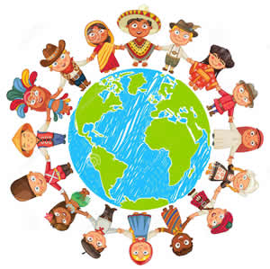
Custom and Tradition
Notes:
This is the template for slides with only an image

Slide 14
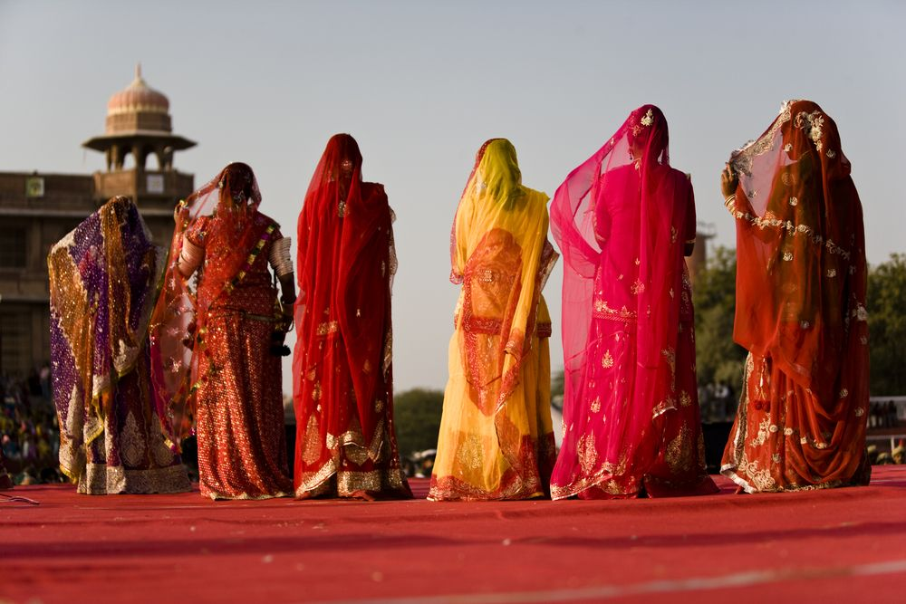
ANALYTICAL WRITING
BUSINESS ETIQUETTE
Customs and Etiquette
Notes:
CUSTOMS AND ETIQUETTE
Indian etiquette is an unusual mixture of British and Asian influences. Therefore in some ways their customs will seem familiar to westerners, and in other ways they differ greatly. Some of the ways in which Indian etiquette differs from western etiquette are as follows: Dining etiquette can be very different in India. It is considered proper to eat with your hands, and in a lot of restaurants or when you are eating with locals, cutlery may not be provided, though in most places spoons can be provided if asked for. If you do try to eat using your fingers, make sure you only use your right hand and not your left, even if you are left-handed, as the left- hand is considered to be ‘unclean’. Also, as common sense would suggest, your fingers will be dirty from eating with them, and as such do not try to serve yourself so as to avoid dirtying the serving spoon, but wait to be served by a waiter or your host.
Sharing of food is good Indian manners, and it is common in restaurants to order a number of dishes and share them all between the members of your party. However, never share cutlery or drink from someone else’s glass or take food from someone’s personal plate, as this is considered very offensive. Never say ‘thank you’ at the end of a meal, but praising the food and showing your appreciation as you eat will be well received. Social etiquette varies greatly across different regions. In general, if you are planning to host an event to be attended by Indian people, then expect them to be late. Contrary to in Western society, it is considered bad manners in India to arrive on time, and good manners would be to arrive 15 to 30 minutes late. It is also acceptable for invited guests to bring other guests with them such as friends or business colleagues. As such, when providing food and drink it is always better to over-cater and to organise a buffet rather than a served meal. It would also be a good idea to telephone all of your intended guests the day before an event, as this is considered polite, even where written invitations have been sent out before-hand.

Slide 15

ANALYTICAL WRITING
Traditional Etiquette
Notes:
TRADITIONAL ETIQUETTE
Following are some of the traditional etiquette followed in India.
• In India you are likely to encounter two types of companies. The first is a traditional, family-run business, the second being a more modern hi-tech operation working with western business methodology.
• Being the boss usually means ‘the boss’ in India. As the boss you are expected to ‘play the part.’ Senior managers are not expected to engage in work which could be done by somebody lower down the organisation.
• Most decisions are made at the top of an organisation and it can be a waste of time negotiating at the middle levels of a company if top level approval has not already been given.
• Working hours in India usually start from 10am. However, some companies in large cities such as Mumbai are known to start as early as 7.30am. This is an attempt to avoid congestion.
• There is and has been a hierarchical culture in India for a long time. Therefore greeting the eldest or most senior person first is usually most common.
• Indians consider it important to use a person's title wherever it is possible, titles such as "Doctor" or "Professor" etc. Use courtesy titles such as “Mr”, “Mrs”, or “Miss” for those without professional titles and wait to be invited to use first names.
• Indians don't like using the word "no" as it is considered negative. Instead, what is common is to use something more acceptable like "maybe" or even just telling the individual whatever they want to hear. In terms of body language, if they say "yes" to a question while bobbling their head (a mixture between a shake and a nod), that generally signifies "no".
• Sustained eye contact is not generally the norm, especially for a woman looking at a man.
• Indians do not generally touch as part of communication.
• The distance between people is usually 3 feet apart.
• Standing with your hands on your hips will be interpreted as an angry, aggressive posture.
• Never point your feet at another person as feet are considered unclean.
• Do not touch someone else's head, not even to pat the hair of a child. The head is considered the seat of the soul. The above mentioned points are the Traditional Etiquette followed in India and let us now see Cross Cultural Competence.

Slide 16

ANALYTICAL WRITING
BUSINESS ETIQUETTE
What is Cross Cultural Competence?
Notes:
CROSS CULTURAL COMPETENCE – WHAT IS IT?
In the workplace setting, cross-cultural competence means workers have the ability to understand, communicate, and effectively interact with people across cultures, be it their colleagues, customers, clients, or suppliers.
Culturally competent businesses and organizations are those with policies, practices and systems designed to support and facilitate effective cross-cultural interactions in all areas of human relations, including recruitment, hiring, and retention practices.

Slide 17
ANALYTICAL WRITING
Core Aspects of Cross Culture
Stay focused on your goals
Understand the culture within yourself
Manage your attitudes towards the culture
Direct your learning of the culture
Develop reliable information sources
Notes:
CORE ASPECTS OF CROSS CULTURE
Following are some of the core aspects of cross cultural competence.
1. Stay focused on your goals : If you’re overseas for work, then building intercultural relationships is not just for fun. Building relationships will help you get your work done.
2. Understand the culture within yourself : Keep aware of the fact that you see the world in a particular way because of your own background, personal history, and culture.
3. Manage your attitudes towards the culture : You don’t always have to love the culture. But you do have to keep check on your reactions to values and customs that are different from your own. The first two principles can also help you manage your attitudes.
4. Direct your learning of the culture : Don’t expect a book or training course to hand you the answers. Try to make sense of the culture for yourself, using the information you come across as clues.
5. Develop reliable information sources : Find two or three locals to get answers from about the culture. Build the relationships so you feel comfortable asking about most anything. Check with more than one and compare their answers in your head.

Slide 18
ANALYTICAL WRITING
Core Aspects of Cross Culture
Learn about the new culture efficiently
Cope with cultural surprises
Formulate cultural explanations of behaviour
Take a cultural perspective
Notes:
CORE ASPECTS OF CROSS CULTURE
6. Learn about the new culture efficiently : You can’t learn everything about the culture before your trip. It’s unrealistic. Focus on learning a few things that fit your interests, and use those to make connections and learn more while you are abroad.
7. Cope with cultural surprises : No matter how much you prepare in advance, you will find yourself faced with people acting in ways that you find puzzling. When you do, try to find out why. Doing so will often lead to new insights.
8. Formulate cultural explanations of behaviour : Routinely try to explain to yourself why people act as they do in this culture, differently from your own. Using things you know about the culture to explain behaviour will help you build a deeper understanding of the culture overall.
9. Take a cultural perspective : Try to see things from the point of view of the people from the other culture. By taking a cultural perspective, you may create a whole new understanding of what’s going on around you.

Slide 19

ANALYTICAL WRITING
What is IEP?
Notes:
IEP – WHAT IS IT?
IEP stands for Inter culturally Effective Person. Following are the features of Inter Culturally Effective Person An individual who is
• Able to live contentedly and work successfully in another culture.
• Able to communicate with people of another culture in a way that earns their respect and trust.
• Capable of adapting his/her professional skills (both technical and managerial) to fit local conditions and constraints.
• Capable of adjusting personally so that she/he is content and generally at ease in the host culture.

Slide 20

ANALYTICAL WRITING
Core Competencies of IEP
Notes:
CORE COMPETENCIES OF IEP
Following are the nine core competencies of Inter Culturally Effective Person
1. Adaptation Skills
2. An attitude of modesty and respect
3. An Understanding of the concept of culture
4. Knowledge of host country and culture
5. Relationship Building
6. Self-Knowledge
7. Intercultural Communication
8. Organizational Skills
9. Personal and Professional Commitment. If a person satisfies the above mentioned competencies, then he is an IEP.

Slide 21

Value
Notes:
This is the template for slides with only an image

Slide 22
ANALYTICAL WRITING
Social Etiquette and Business Etiquette
Social Etiquette
Marked by Courtesy
Gender plays a role
Business Etiquette
Marked by Hierarchy and Power
Gender has no role.
Notes:
SOCIAL ETIQUETTE AND BUSINESS ETIQUETTE
Social Etiquette
• Marked by Courtesy
• Gender plays a role
Business Etiquette
• Marked by Hierarchy and Power
• Gender has no role.

Slide 23
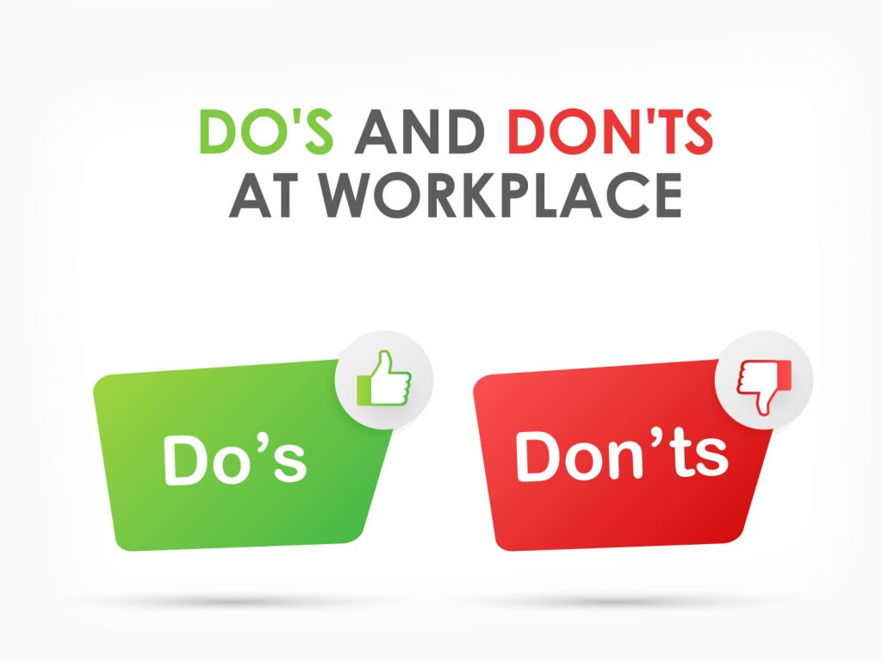
ANALYTICAL WRITING
Do's and Don'ts at Workplace
Notes:
DO’S AND DON’TS IN WORKPLACE
Often, it’s a simple matter of using your common sense and behaving in a manner that shows courtesy and respect for others but there are numerous things that you should obviously not get involved with or encourage. Here’s a list of some of the most commonly cited examples of behaviour that is often frowned upon and even not tolerated by most companies, regardless of type. Disregarding these, it can often, at best, make you unpopular or, at worst, might even get you the sack.
Things you shouldn’t do at work include:
• Engage in idle gossip about other colleagues or your boss or ‘bad mouth’ them
• Don’t get involved in any banter which might have sexual or racial overtones
• Be modest and don’t harp on about any of your previous achievements or be an attention seeker
• Don’t try to court favour with your boss or immediate supervisors. Just doing your job in the best way you can is the most productive way of impressing those higher up the ladder than you
• Don’t assume something is acceptable practice in either conversations you might have or actions you might consider taking. A good example of this is assuming that it’s OK to leave your mobile phone on silent or vibrate, yet still respond to text messages, for example. Establish the position on that and other things you’re not sure about first such as eating at your desk or work station, which is another good example where people often do the wrong thing. Workplace Dos There are a number of things that you should do if you want to be seen as a valuable member of the team and to be considered a valued colleague.
These can include:
• Being respectful and courteous towards others - even if you don’t necessarily like a particular person
• Keep your voice at an acceptable level. A loud voice which is noticeable in a particular work environment can not only be counterproductive for others who are trying to get on with their work but can be extremely annoying too.
• Offer to help others if there’s anything you might be able to do to assist them and make their job easier if you’ve time to do so
• Dress appropriately and adopt a similar degree of formality/informality once you’ve established the acceptable ‘code of conduct’
• Make sure you understand the rules surrounding e-mail etiquette and the use of your mobile phone
• Remember you’re being paid to work so keep idle chit-chat and other things that may take your attention away from what you’ve been employed to do to a minimum.
• Stay positive and upbeat and smile These are just simple dos and don’ts which reflect general workplace etiquette in most workplaces and are often as much about using your own common sense as anything else.

Slide 24
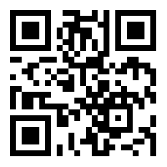
https://learn.codemithra.com

Slide 25




THANK YOU
+91 78150 95095
codemithra@ethnus.com
www.codemithra.com

